Slide 1
Linux Users
Darius Kianersi

Slide 2
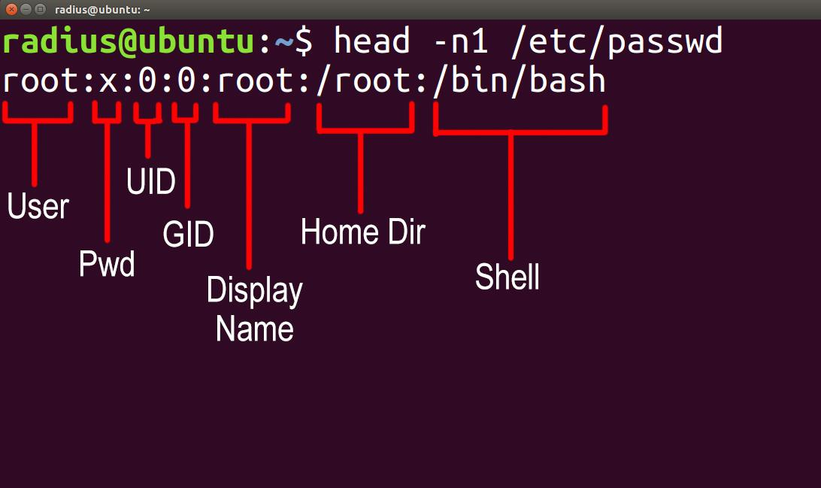
/etc/passwd
Stores information for all users
Globally accessible
UIDs from 1-999 are system/predefined accounts
UIDs >= 1000 are user accounts

Slide 3
Relevant Commands
Add user: useradd USERNAME
Delete user: userdel USERNAME
Add user to group: adduser USER GROUP
Remove user from group: deluser USER GROUP
Change shell: usermod -s SHELL USER
Change uid: usermod -u UUID USER
Change password: passwd USER

Slide 4
One-liner Examples
grep -E ‘:[0-9]{4}:’ /etc/passwd | cut -d ‘:’ -f 1
for i in $(grep -E ‘:[0-9]{4}:’ /etc/passwd | cut -d ‘:’ -f 1); do sudo passwd $i; done

Slide 5
Hidden Users
System users (UID<1000) with shells that can be logged into
/bin/sh
/bin/bash
/bin/zsh
Remediation: delete user, change shell to /bin/false, /usr/bin/slogin

Slide 6
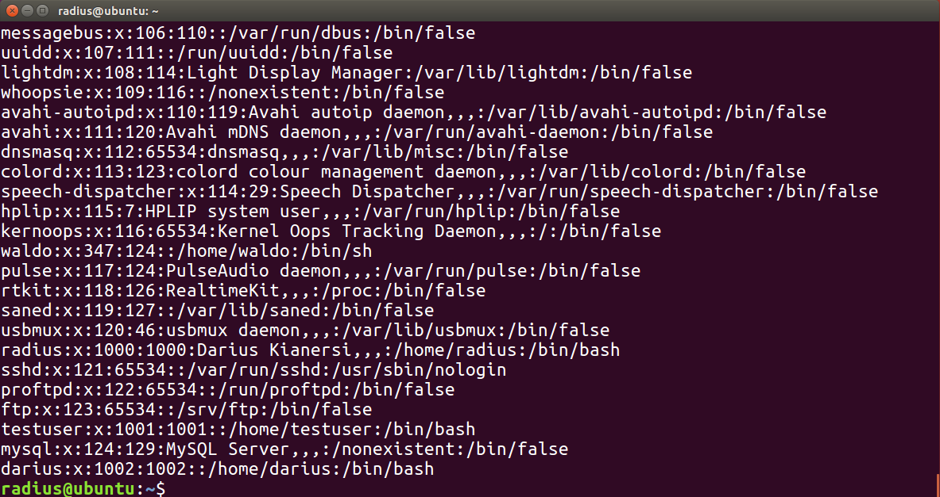

Slide 7
chage
Relevant Flags:
-m, --mindays NUM_DAYS # recommend 2
-M, --maxdays NUM_DAYS # recommend 30
-I, --inactive NUM_DAYS # recommend 30
-W, --warndays NUM_DAYS # recommend 7
Usage:
chage -m 2 -M 30 -I 30 -W 7 radius
chage -l radius
Notes:
PAM doesn't affect existing users
Min days to change a password again
Max days for a password to be valid
Number of days of inactivity after a password expires before account is locked
Number of days of warning before the user’s password expires

Slide 8
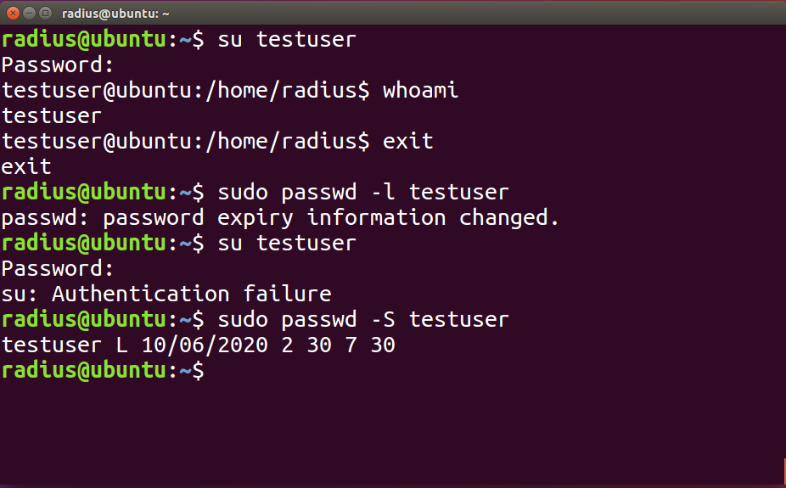
Password Expiry
Unlock: passwd -u USER
Lock: passwd -l USER
View Status: passwd -S USER

Slide 9
1. Add user jhalpert to group salesmen
2. Change shell of user pbeesly to /bin/sh
3. Lock the account of user mscott

Slide 10
1. adduser jhalpert salesmen
2. usermod -s /bin/zsh pbeesly
3. passwd -l mscott

